Slide 1

Department of Computer Science and Engineering
Neural Network – Based Named Entity Recognition for Bodo : A Deep Learning Approach
PRESENTED BY
P. Nikhitha
Sd. Mahishabi
A. Ranga Lakshmi
(21471A05O1)
(22475A0515)
(21471A05L4)
Under the Guidance of,
Dr. K. LakshmiNadh M. Tech. , Ph. D.,
Professor,
Department of Computer Science and Engineering,
Narasaraopeta Engineering College (Autonomous), Narasaraopet- 522 601.
Review No.1
Department of CSE

Slide 2
OUTLINE
Abstract
Introduction
Literature Survey
Research Gaps
Problem Statement
Objectives
Block Diagram / Flow Diagram
Methodology
Implementation
Results and Analysis
Conclusion & Future Scope
References
Question and Answers
Acknowledgements
Review No.1
Department of CSE

Slide 3
ABSTRACT
Named Entity Recognition (NER) is essential in NLP for tasks like information extraction, machine translation, and question answering.
Bodo, a low-resource language, lacks annotated datasets and linguistic resources.
This project proposes a deep learning-based NER system for Bodo using LSTM, GRU, and CNN.
Data augmentation and transliteration techniques help overcome data scarcity.
Experimental results show that CNN achieves the highest accuracy (99.91%), followed by GRU (99.36%) and LSTM (96.5%).
This research contributes to improving NER for low-resource languages and highlights the effectiveness of deep learning in handling linguistic challenges.
Review No.1
Department of CSE

Slide 4
INTRODUCTION
Brief introduction to the project
This project focuses on developing a Named Entity Recognition (NER) system for the Bodo language, which identifies and classifies entities like names, locations, and dates in text. Since Bodo is a low-resource language, the project uses deep learning techniques like LSTM, GRU, and CNN, along with data augmentation and transliteration methods, to improve performance. The aim is to address the lack of resources and advance NLP for underrepresented languages.
Review No.1
Department of CSE

Slide 5
Motivation behind the project
Resource Development: The project aims to address the lack of annotated data and tools for the Bodo language, enabling effective NLP applications.
Cultural Preservation: By enhancing technology for the Bodo language, the project helps preserve its cultural and linguistic heritage in the digital world.
Broader Impact: A successful NER system can improve various applications like information extraction and machine translation, benefiting both Bodo speakers and researchers.
Review No.1
Department of CSE

Slide 6
Importance and relevance
Significance in Technology Development:
The project is important as it addresses the technological gap for low-resource languages, enabling the development of tools and applications that can process and understand Bodo language data effectively.
Cultural Preservation:
It is relevant for preserving the cultural identity and linguistic heritage of the Bodo community, ensuring that the language remains accessible and usable in the digital age.
Review No.1
Department of CSE

Slide 7
LITERATURE SURVEY
No | Title | Author | Journal Name & Year | Methodology Adapted | Key Findings | Gaps
1 | Deep Learning based Named Entity Recognition for the Bodo Language | Narzary, S., Brahma, A., Nandi, S., and Som, B. | Procedia Computer Science, 2024, https://www.sciencedirect.com/science/article/pii/S1877050924009049 | Utilizes deep learning models such as LSTM, GRU, and CNN for NER tasks. | The CNN model achieved the highest accuracy of 99.91%, demonstrating the effectiveness of deep learning techniques for NER in low-resource languages. | Limited exploration of hybrid models combining rule-based approaches with deep learning techniques.
2 | Data Augmentation for Bodo Named Entity Recognition | Nath, R., and Mahanta, B. | International Journal of Data Science and Analysis, 2023, https://www.sciencedirect.com/science/article/pii/S1877050924009049 | Focuses on data augmentation techniques to enhance the training dataset for NER. | Data augmentation significantly improved the performance of NER models by increasing dataset diversity. | The study primarily focuses on augmentation without addressing the integration of these techniques into existing models.
3 | Named Entity Recognition for Hindi Language using Context Pattern-Based Maximum Entropy | Jain, A., Yadav, D., Arora, A., and Tayal, D. K. | International Journal on Natural Language Computing (IJNLC), 2022, https://www.researchgate.net/publication/359457017_Named-Entity_Recognition_for_Hindi_language_using_context_pattern-based_maximum_entropy | Employs a context pattern-based maximum entropy model for NER tasks. | The model demonstrated improved accuracy in identifying named entities in Hindi, providing insights applicable to other languages like Bodo. | The methodology may not be directly applicable to Bodo due to linguistic differences.
Review No.
Department of CSE

Slide 8
LITERATURE SURVEY
No | Title | Author | Journal Name & Year | Methodology Adapted | Key Findings | Gaps
4 | Named Entity Recognition for Malayalam Language: A CRF-based Approach | Prasad, G., Fousiya, K.K., Kumar, M. A., and Soman, K.P. | Journal of Ambient Intelligence and Humanized Computing, 2022, https://ieeexplore.ieee.org/document/7225384 | Uses Conditional Random Fields (CRF) for sequence labeling in NER. | The CRF model showed significant improvements in accuracy for Malayalam, suggesting potential applicability to Bodo NER systems.. | The study does not explore deep learning techniques, which may offer better performance.
5 | Active Learning for Named Entity Recognition in Kannada | Aparna, M., and Srinivasa, S. | Proceedings of the 16th International Conference on Natural Language Processing (ICON), 2021, https://www.researchgate.net/publication/375976751_Active_learning_for_Named_Entity_Recognition_in_Kannada | Implements active learning techniques to iteratively improve NER performance. | Active learning significantly reduced the amount of labeled data needed while maintaining high accuracy. | The focus on Kannada limits the direct applicability of findings to the Bodo language.
Review No.1
Department of CSE

Slide 9
LITERATURE SURVEY
Enter minimum of 5 papers related to your objective
Deep Learning based Named Entity Recognition for the Bodo Language-To develop a deep learning-based NER system specifically for the Bodo language.
Data Augmentation for Bodo Named Entity Recognition- To explore data augmentation techniques to enhance the performance of NER models for the Bodo language.
Named Entity Recognition for Hindi Language using Context Pattern-Based Maximum Entropy-To apply context pattern-based maximum entropy models for NER, providing insights applicable to other languages like Bodo.
Named Entity Recognition for Malayalam Language-A CRF-based Approach-To investigate CRF-based approaches for NER in Malayalam, which can inform similar approaches for Bodo.
Active Learning for Named Entity Recognition in Kannada-To implement active learning techniques to improve NER performance, relevant for low-resource languages like Bodo.
Review No.
Department of CSE

Slide 10
Relevant literature summary
Deep Learning Models : Studies show that models like LSTM, GRU, and CNN are effective for improving NER in low-resource languages. They can learn complex patterns in data.
Data Augmentation: Techniques such as synonym replacement, back translation, and transliteration are used to create more training examples. This helps improve the performance of NER systems.
Performance Evaluation: Studies use metrics like accuracy, precision, recall, and F1 score to assess NER systems. Deep learning models often perform better than traditional methods.
Review No.1
Department of CSE

Slide 11
Highlight key findings and their relation to your project
Key Findings:
There is a lack of annotated data and linguistic tools for low-resource languages.
Combining rule-based methods with machine learning can improve accuracy.
More annotated datasets are needed for low-resource languages.
2. Relation to Project:
The project aims to develop a dedicated Bodo NER dataset and tools to address these challenges.
The project may explore hybrid models to enhance Bodo NER performance.
The project will focus on creating a well-annotated Bodo NER dataset to support future research.
Review No.1
Department of CSE

Slide 12
RESEARCH GAPS
Limited Annotated Datasets:
There aren't enough high-quality, annotated datasets for languages like Bodo.
Language-Specific Features:
Existing NER systems often overlook the unique linguistic characteristics of low-resource languages.
Data Augmentation Techniques:
There is a need for more innovative and tailored data augmentation methods for low-resource languages.
Performance Evaluation:
Current evaluation methods may not consider the specific challenges of low-resource languages.
Multilingual NER Systems:
There is a lack of focus on developing NER systems that can handle multiple low-resource languages at once.
Review No.
Department of CSE

Slide 13
PROBLEM STATEMENT
Problem Addressed:
The major problem being addressed is the lack of an effective Named Entity Recognition (NER) system for the Bodo language, which is a low-resource language. This issue arises from several interconnected challenges, including the scarcity of annotated datasets, inadequate linguistic resources, poor model performance due to unique linguistic features, limited exploration of hybrid approaches, underutilization of data augmentation techniques, and insufficient contextual understanding in existing models.
Significance:
Cultural Preservation: Developing an NER system helps keep the Bodo language and culture alive in the digital world.
Improving Technology Use: An effective NER system enhances applications like translation and information extraction, making technology more useful for Bodo speakers.
Review No.
Department of CSE

Slide 14
OBJECTIVES
Create a high-quality, annotated dataset specifically for the Bodo language to facilitate the training and evaluation of NER models.
Utilize state-of-the-art deep learning models, such as LSTM, GRU, and CNN, to improve the accuracy and performance of the NER system for the Bodo language.
Investigate and apply innovative data augmentation techniques to expand the training dataset and enhance model robustness.
Assess the performance of the developed NER system using standard metrics (accuracy, precision, recall, F1 score) and optimize the model based on evaluation results to ensure effective entity recognition in Bodo text.
Review No.1
Department of CSE

Slide 15
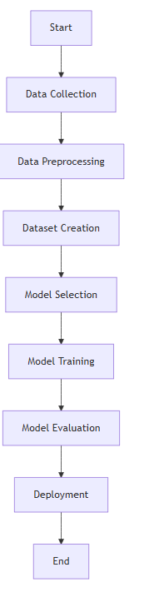
BLOCK DIAGRAM OR FLOW DIAGRAM
Review No.1
Department of CSE

Slide 16
METHODOLOGY
Data Preprocessing:Data preprocessing is crucial for preparing the Bodo NER dataset for effective model training and evaluation. It involves several steps to clean and normalize the data.
Normalization:Convert all text to a consistent case (e.g., lowercase) to reduce variability. Remove unwanted punctuation and special characters.
Tokenization:Split the text into individual words or tokens to facilitate analysis.
Part-of-Speech (PoS) Tagging:Assign PoS tags to each token to understand the grammatical structure of sentences, which is important for NER tasks.
Named Entity Tagging:Mark tokens with named entity tags (e.g., PERSON, ORGANIZATION, LOCATION) according to a predefined NER tagset.
Handling Missing Tags:Fix any missing tags to ensure the dataset is complete and ready for training.
Tools Used:Python libraries such as NLTK or SpaCy for tokenization and PoS tagging.
Review No.
Department of CSE

Slide 17
2. Exploratory Data Analysis (EDA):
EDA is performed to understand the dataset better, identify patterns, and inform model selection and feature extraction.
Statistical Analysis:Analyze the distribution of different entity types in the dataset (e.g., number of PERSON, ORGANIZATION, LOCATION entities).
NER Tag Statistics:Generate statistics for the number of words and entities per each type of entity in the training, development, and test sets.
3.Data Splitting: To ensure that the model is trained and evaluated properly.
Dataset Division:Split the dataset into three subsets:
Training Set: Used to train the model.
Development Set: Used for tuning model parameters and hyperparameters.
Test Set: A separate set used exclusively for evaluating the model's performance.
Typical Split Ratios:
Training Set: 70%
Development Set: 15%
Test Set: 15%
Review No.1
Department of CSE

Slide 18
4. Model Selection and Frameworks:
Frameworks Used:TensorFlow/Keras
Deep Learning Models:
Long Short-Term Memory (LSTM): Captures long-term dependencies in sequential data.
Gated Recurrent Unit (GRU): A simpler alternative to LSTM, efficient for sequence prediction tasks.
Convolutional Neural Networks (CNN): Used for both word and character-level feature extraction.
5.Feature Extraction:
Word-Based Features:Each word in the input text is treated as a feature.
Character-Based Features:CNN techniques are used to learn from individual characters of words, which is useful for morphologically rich languages like Bodo.
Bidirectional Techniques:Bidirectional LSTM is employed to capture context from both directions (left to right and right to left).
Pre-trained Word Embeddings:GloVe embeddings are used to represent words in a continuous vector space, capturing semantic relationships.
6.Model Evaluation:Establish metrics such as accuracy, precision, recall, and F1 score to evaluate the model's performance.

Slide 19
IMPLEMENTATION
1. Hardware Requirements:
Processor : Intel Core i5 or higher.
RAM: Minimum 8GB
Storage: SSD with at least 256 GB of storage for faster data access and model training.
2. Software Requirements:
Operating System : Windows, macOS, or Linux
Programming Language: Python 3.x
Development Environment : Jupiter Notebook or an Integrated Development Environment (IDE) like PyCharm or Visual Studio Code for Coding and testing.
Review No.1
Department of CSE

Slide 20
Challenges:
Limited Annotated Data for Bodo Language:
Solution: Implemented data augmentation techniques such as synonym replacement and back-translation to increase the dataset size and diversity.
2. Model Overfitting:
Solution: Used dropout layers in the neural network architecture and applied early stopping during training to prevent overfitting.
3. Computational Resource Limitations:
Solution: Utilized cloud computing resources (e.g., Google Colab or AWS) to access powerful GPUs for faster model training.
4. Hyperparameter Tuning Difficulties:
Solution: Employed grid search and random search methods to systematically explore and optimize hyperparameters.
5. Understanding Model Predictions:
Solution:Used confusion matrices and classification reports to analyze model performance and identify specific areas for improvement.
Review No.1
Department of CSE

Slide 21
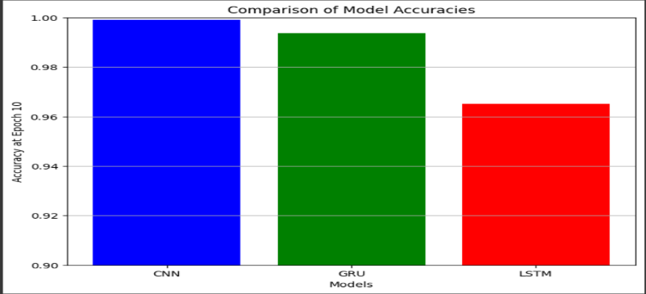
RESULTS & ANALYSIS
MODEL | ACCURACY(%) | PRECISION(%) | RECALL(%) | F-SCORE(%)
CNN | 99.91 | 98.68 | 96.79 | 97.23
GRU | 99.36 | 97.75 | 98.94 | 96.35
LSTM | 96.50 | 98.52 | 96.88 | 97.20
Fig1: Model Performance
Fig2:Comparison of Model Accuracy
Review No.1
Department of CSE

Slide 22
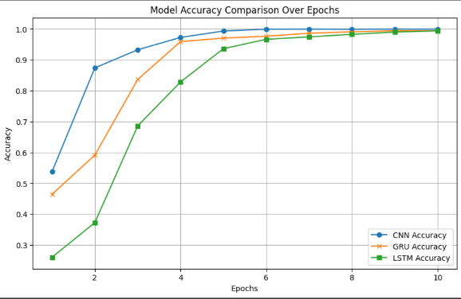
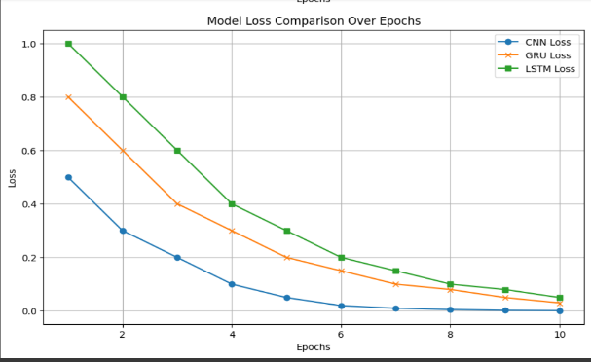
Fig 3: Model Accuracy
Fig 4: Model Loss
Review No.1
Department of CSE

Slide 23
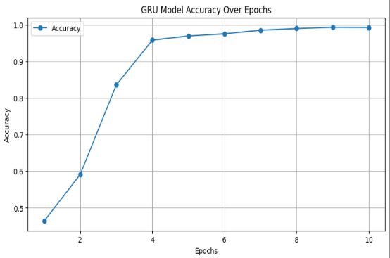
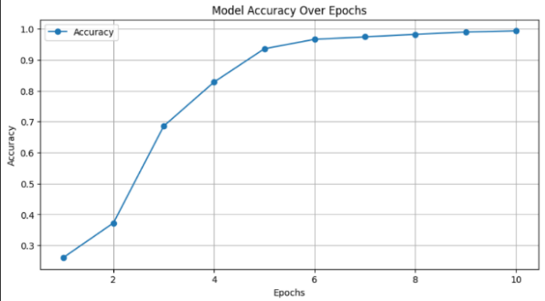
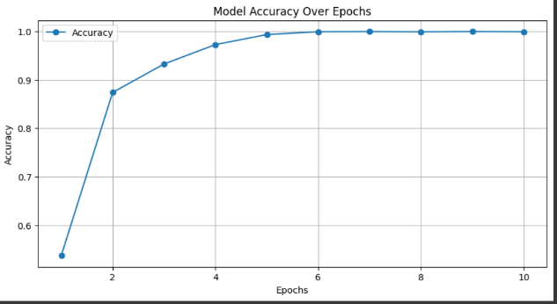
Fig 5: Accuracy of GRU model
Fig 6: Accuracy of LSTM model
Fig 7: Accuracy of CNN model
Review No.1
Department of CSE

Slide 24
CONCLUSION and FUTURE SCOPE
Conclusion
The NER project for the Bodo language successfully utilized deep learning techniques, achieving a high accuracy of 99.91% with the CNN model, which outperformed LSTM and GRU models. The project effectively addressed the challenge of limited annotated data through data augmentation, enhancing the training dataset and improving model performance. Insights from the confusion matrix highlighted areas for improvement in entity classification. Overall, this project not only advanced NER capabilities for the Bodo language but also set the stage for future research in multilingual NER applications, demonstrating the potential of deep learning in natural language processing for under-resourced languages.
Review No.1
Department of CSE

Slide 25
CONCLUSION and FUTURE SCOPE
Future Scope
The future scope of the NER project for the Bodo language includes refining the model by exploring advanced architectures like Transformers (e.g., BERT) to enhance accuracy and contextual understanding. Additionally, there is potential to develop multilingual NER systems that can support multiple under-resourced languages, facilitating broader applications in natural language processing. Further research could also focus on integrating more diverse datasets and improving the model's ability to handle various linguistic challenges, ultimately contributing to the advancement of NER technologies in low-resource settings.
Review No.1
Department of CSE

Slide 26
Limitations
The future scope of the NER project for the Bodo language includes refining the model by exploring advanced architectures like Transformers (e.g., BERT) to enhance accuracy and contextual understanding. Additionally, there is potential to develop multilingual NER systems that can support multiple under-resourced languages, facilitating broader applications in natural language processing. Further research could also focus on integrating more diverse datasets and improving the model's ability to handle various linguistic challenges, ultimately contributing to the advancement of NER technologies in low-resource settings.
Review No.1
Department of CSE

Slide 27
REFERENCES
[1] Narzary, S., Brahma, A., Nandi, S., & Som, B. (2024). Deep Learning based Named Entity Recognition for the Bodo Language. Procedia Computer Science, 235, 2405-2421.
[2] Nath, R., & Mahanta, B. (2023). "Data Augmentation for Bodo Named Entity Recognition," in International Journal of Data Science and Analysis, Vol. 9, No. 2.
[3] Arti Jain, Divakar Yadav, Anuja Arora, Devendra K. Tayal (2022), "Named Entity Recognition for Hindi Language using Context Pattern-Based Maximum Entropy," in International Journal on Natural Language Computing (IJNLC), Vol. 23, No. 1.
[4] Gowri Prasad, K.K. Fousiya, M. Anand Kumar, and K.P. Soman (2022), "Named Entity Recognition for Malayalam Language: A CRF-based Approach," in Journal of Ambient Intelligence and Humanized Computing, Vol. 13, pp. 1953-1963.
[5] M. Aparna and Srinath Srinivasa (2021), "Active Learning for Named Entity Recognition in Kannada," in Proceedings of the 16th International Conference on Natural Language Processing (ICON).
Review No.
Department of CSE

Slide 28
[6] C.N. Subalalitha, R. Srinivasan (2019), "Automated Named Entity Recognition from Tamil Documents," in International Journal of Computer Applications, Vol. 178, No. 4.
[7] Brahma, R. and Hazarika, D. (2021). "Named Entity Recognition in Bodo Language Using Conditional Random Fields," in International Journal of Engineering Research & Technology (IJERT), Vol. 10, Issue 5.
[8] Govardhan, A., Yohan, P. P., and Vinaya Babu, A. (2012), "Named Entity Recognition in Telugu Language Using Language Dependent Features and Rule-Based Approach," in International Journal of Computer Applications, Vol. 47, No. 9.
[9] Chakrabarty, T., Das, A., & Sarkar, S. (2016). Transliteration Based Named Entity Recognition for Bengali. In Proceedings of the 2016 Conference on Computational Natural Language Learning (pp. 83-90). ACL.
[10] Bharati, S., Sunkara, D., Singh, M., & Srivastava, R. K. (2016). Named Entity Recognition in Indian Languages using Deep Learning Techniques. In Proceedings of the 13th International Conference on Natural Language Processing (ICON) (pp. 103-110). NLP Association of India.
Review No.
Department of CSE

Slide 29
[11] Devlin, J., Chang, M. W., Lee, K., & Toutanova, K. (2019). BERT: Pre-training of Deep Bidirectional Transformers for Language Understanding. In: Proceedings of the 2019 Conference of the North American Chapter of the Association for Computational Linguistics: Human Language Technologies, 4171-4186.
[12] Liu, Y., & Zhang, Y. (2019). A Survey on Named Entity Recognition: Current Research and Future Directions. Journal of Computer Science and Technology, 34(1), 1-20.
[13] Zhang, Y., & Yang, Q. (2018). A Survey on Multi-Task Learning. IEEE Transactions on Knowledge and Data Engineering, 30(5), 1-1.
[14] Lample, G., Ballesteros, M., Subramanian, S., Kawakami, K., & Dyer, C. (2016). Neural Architectures for Named Entity Recognition. In: Proceedings of the 2016 Conference of the North American Chapter of the Association for Computational Linguistics: Human Language Technologies, 260-270.
[15] Huang, Z., Xu, W., & Yu, K. (2015). Bidirectional LSTM-CRF Models for Sequence Tagging. arXiv preprint arXiv:1508.01991.
Review No.
Department of CSE

Slide 30

QUESTIONS and ANSWERS
ANY QUESTIONS???
Review No.1
Department of CSE

Slide 31
ACKNOWLEGEMENTS
Thank You
Presented By
P. Nikhitha (21471A05O1)
Sd. Mahishabi (22475A0515)
A. Ranga Lakshmi (21471A05L4)
Review No.
Department of CSE

